Slide 1
IoT Ecosystem
Internet of Things
Module lead: Dr Mir Seyedebrahimi

Slide 2
What is IoT?
The term ‘Internet of Things’:
“…describes the pervasive presence of a variety of devices (such as sensors, actuators, mobile phones ..) which, through unique addressing schemes, are able to interact and cooperate with each other to reach common goals.”
So, we consider IoT as:
A network of THINGS which are identifiable and interacting
Source: Peter Marwedel (reading list)

Slide 3
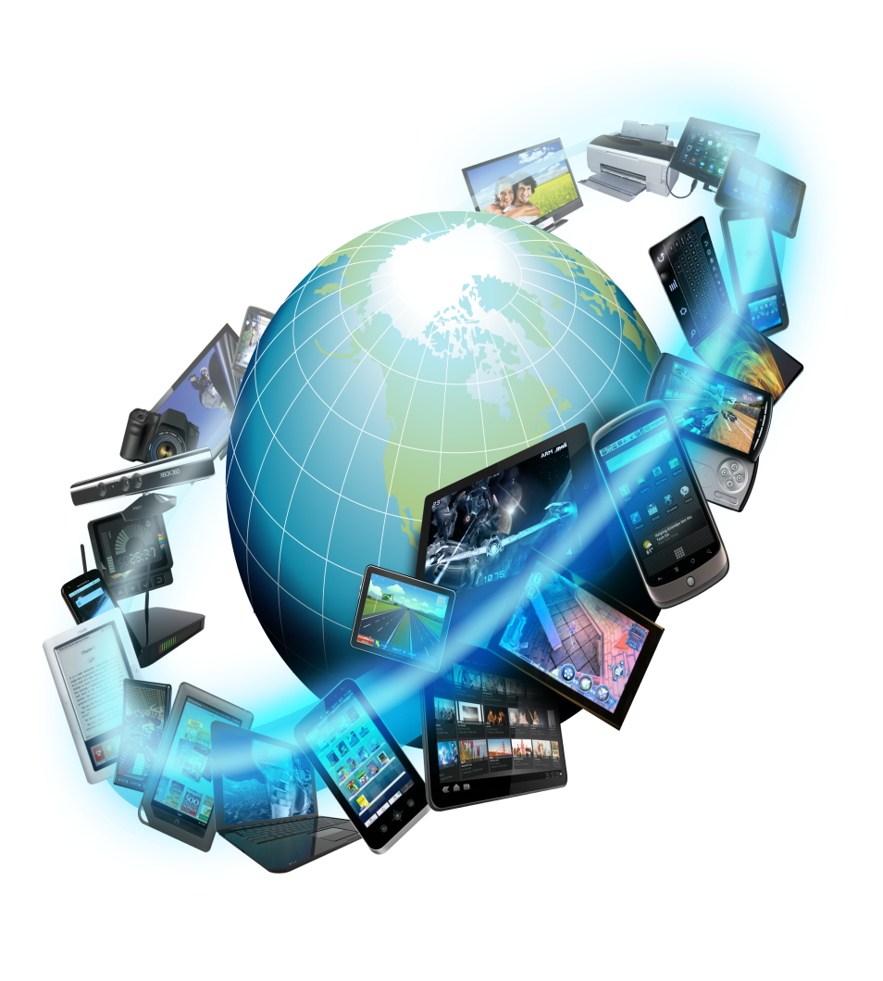
Things?
Things can be:
Smart buildings and home appliances:
e.g. washing machines, TVs, fridges, cookers, doors, chairs…
Wearable devices
e.g. smart watches, smart glasses, rings, clothes
Medical equipment:
e.g. healthcare monitoring, embedded pills
Industrial tools:
e.g. robots, monitoring nodes, actuators
Civil engineering structures:
e.g. bridges, railways …
…
Source: Peter Marwedel, reading list

Slide 4
What is IoT? A chronological order
IoT initially referred to:
the introduction of barcodes and Radio Frequency Identification (RFID), helping to automate inventory, tracking and basic identification
Gradually, IoT characterised:
for connecting sensors, objects, devices, data sources and applications
Recently, IoT has become:
An icon for 4th industrial revolution (Industry 4.0), which comprise a flexible production solution with full life cycle (from design to production) influenced by IoT and Cyber-Physical Systems. Hyper-connectivity, interoperability and enriched information distribution solutions
Notes:
Hyperconnectivity and being connected all the time requires the interoperability to be in place

Slide 5
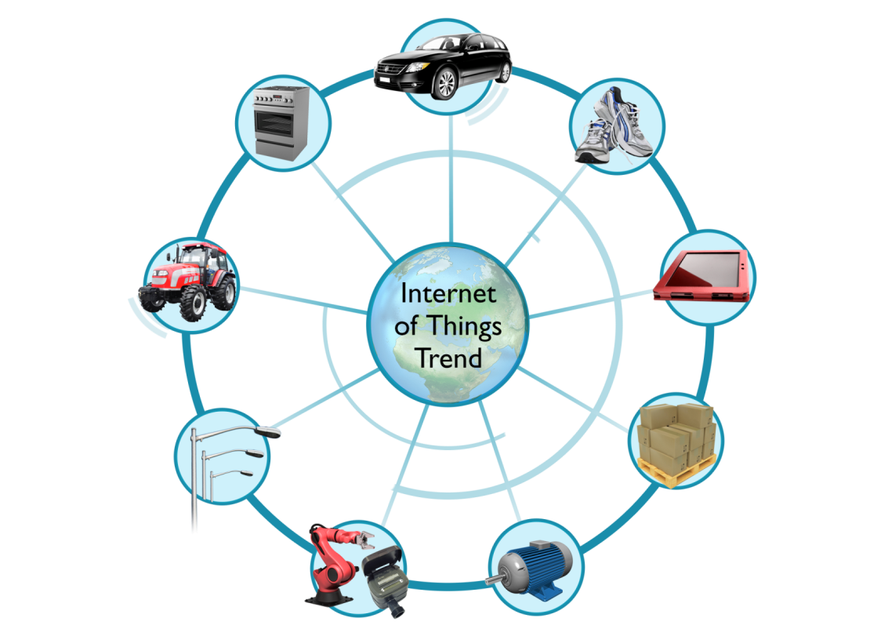
Why IoT?
Safer Automotive
Why IoT is helpful?
Items can express their functionalities and become more intelligent
Items can be managed in an easier way
More information become available
Why IoT is becoming more realistic?
Communication is becoming faster
Embedded chips are becoming:
Smaller
Lower power
Cheaper (in 2021/22 ?!)
Smart Appliances
Fitness / Healthcare
Portable and Wearable
Electronics
Smart Farming
Smart
Lighting
Resource
Management
Machine to Machine
Industrial Internet
Source: ARM training kit

Slide 6
Challenges of Internet of Things
Multiple technological enablers required:
Embedded systems, Communications, Networking, analytical tools etc
Large amount of chips required
Chips have to become cheaper, smaller
Big data demand
Large volume of data will be generated, data centre storage needs to be increased, Computation requirement
Power consumption
Low power chips, longer battery life, and maybe wireless charging…
Security
Large amount of private data need to be protected
Standards
Official standards are required, such as network protocol
Source: ARM training kit

Slide 7
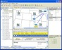




The IoT Opportunity Gap
Opportunity gap
Current trend shows strong growth and this not new, it’s been around for > 30 years¹
Connected things > world population
The IoT Opportunity is much larger than current state and analysts predictions for connected devices (2025):
75 billion?
100 billion?!
possible
Reach
Silos of Things
existing
Time
¹ Weiser, Mark (1991) “the Computer for the 21st Century”

Slide 8
Market penetration
This stats is before the Covid impact!
CAGR = Compound Annual Growth Rate

Slide 9
IoT Growth by Verticals
Verticals: various use cases
And again, this is before the impact of Covid!

Slide 10
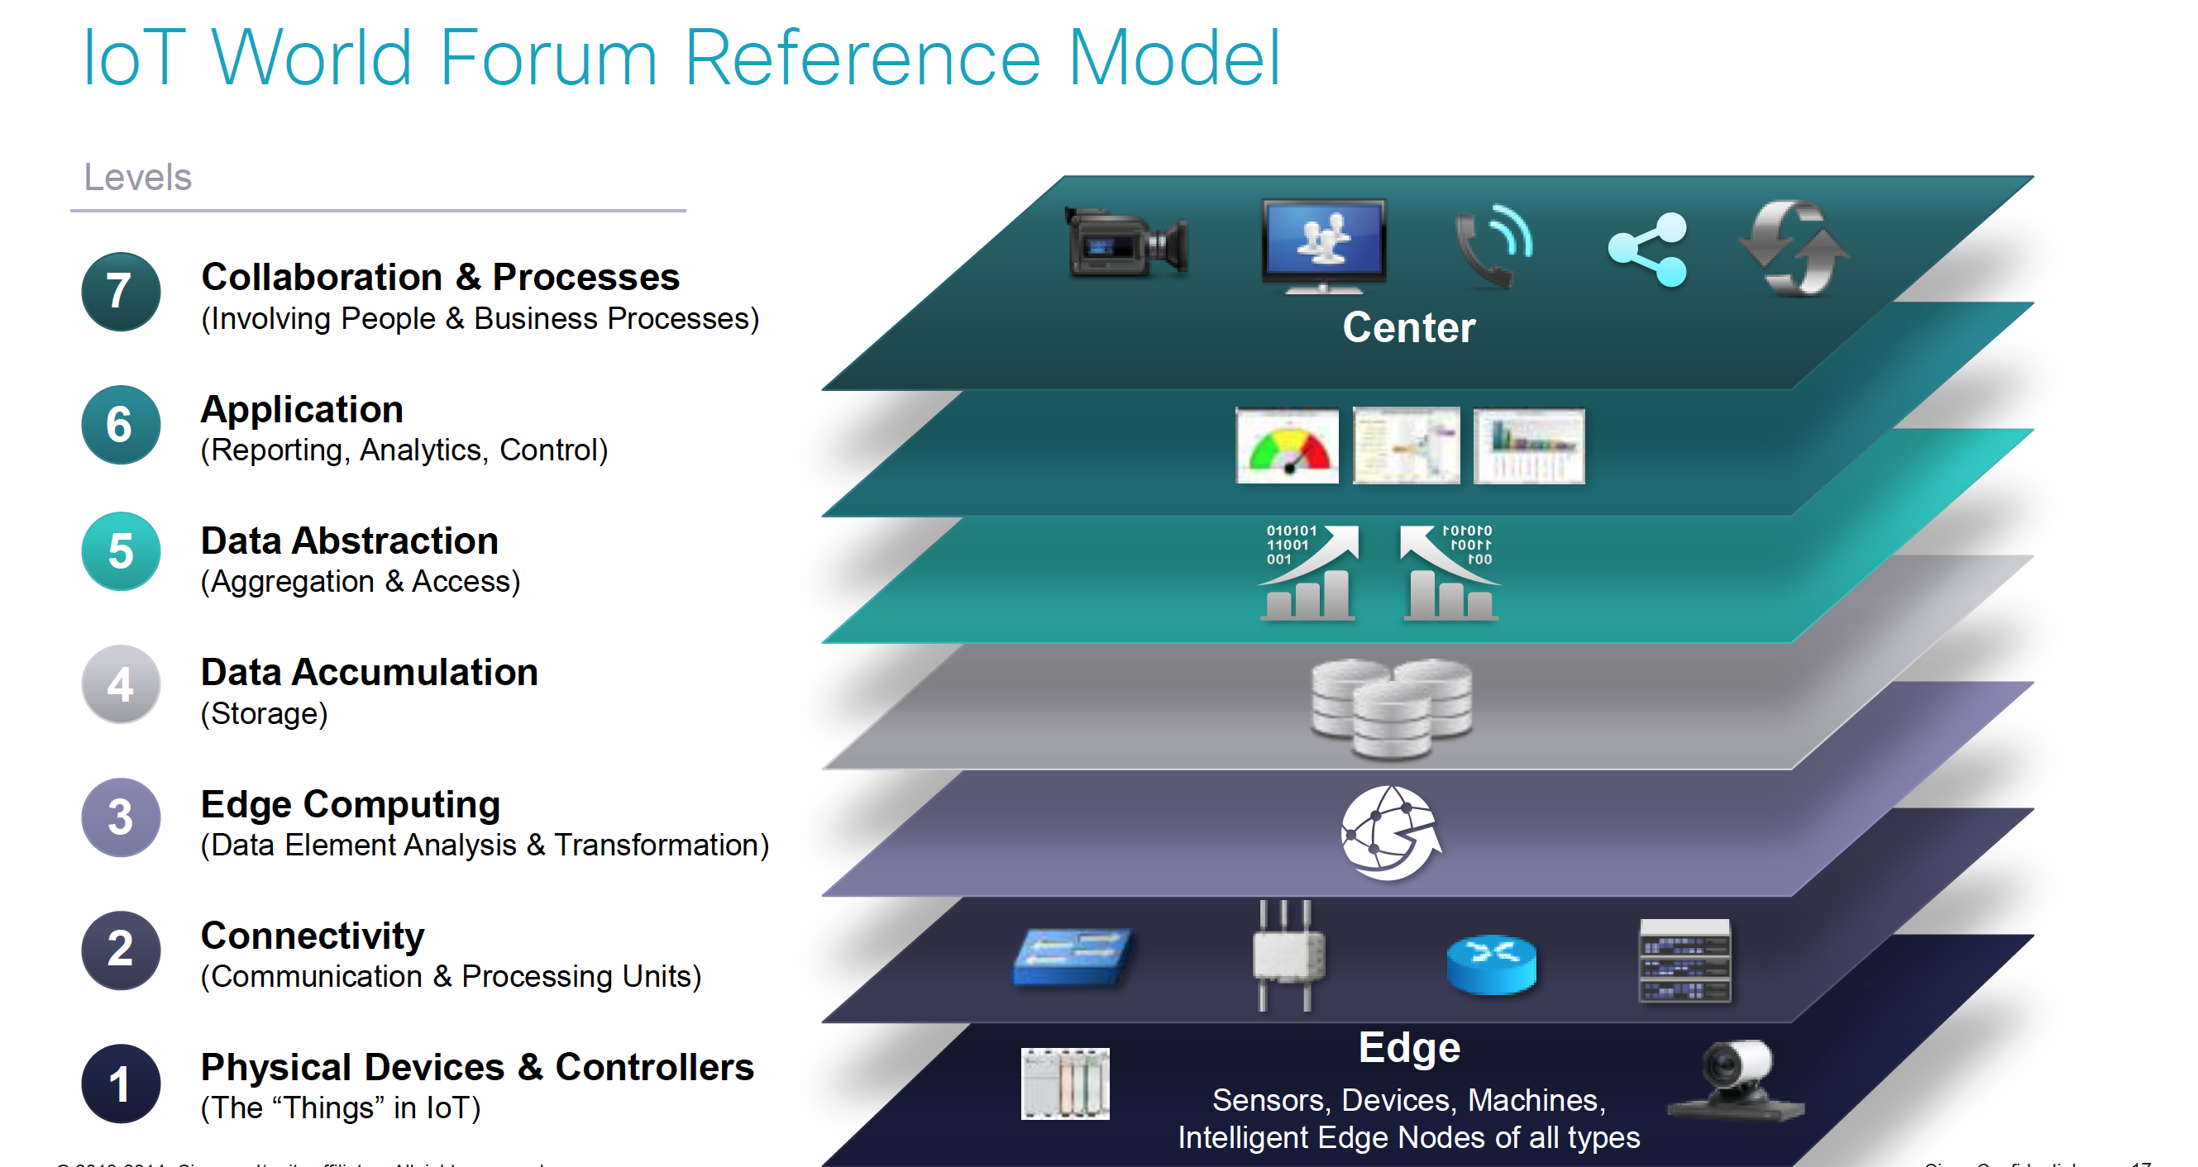
IoT Reference Model
People and Apps
Data acquisition and process
Smart devices, connectivity and mobility
Source: Cisco

Slide 11
IoT reference model: Architectural perspectives
We consider this model for organising our discussion in this module:
Portals/Dashboards/APIs
Analytics/Services
Device/ID Managers
Access Managers
Remaining of the discussions towards the final days
Gateways/Aggregators/Local servers
Communication Protocols
Further study and central theme in your assignment
Device/Thing/SmartThing
Initial teaching topics

Slide 12
IoT reference model: Architectural perspective- example
Analytical tools and user portals
Identification and security management
System boundaries and communications are considered in this module
Remote server/cloud services
Gateway
Local process/analytics
uC
uC
Devices
Devices
Things
Things
Smart Devices

Slide 13
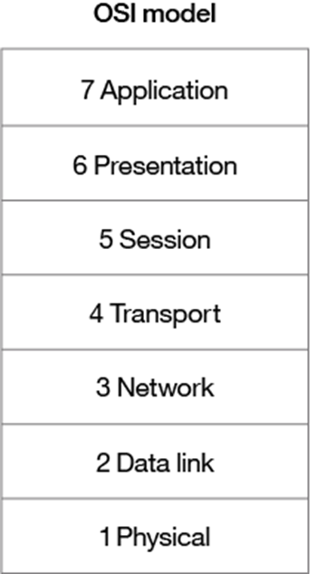
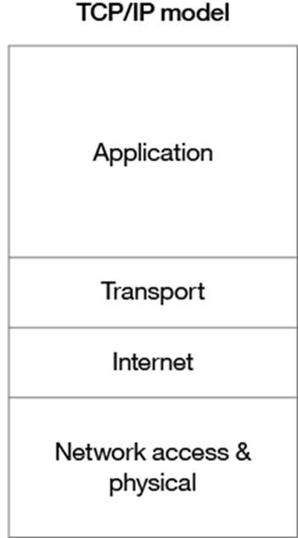
IoT reference model: Networking perspective
A conventional computer network protocol stack comprises:
Process and application
Data presentation and encryption
Inter-host communication
E2E comm. reliability
Path determination and IP
Physical addressing
Media and signal

Slide 14
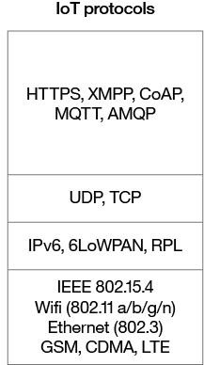
IoT reference model: Networking perspective
IoT protocol stack:
Process and application
Data presentation and encryption
Inter-host communication
E2E comm. reliability
Path determination and IP
Physical addressing
Media and signal

Slide 15
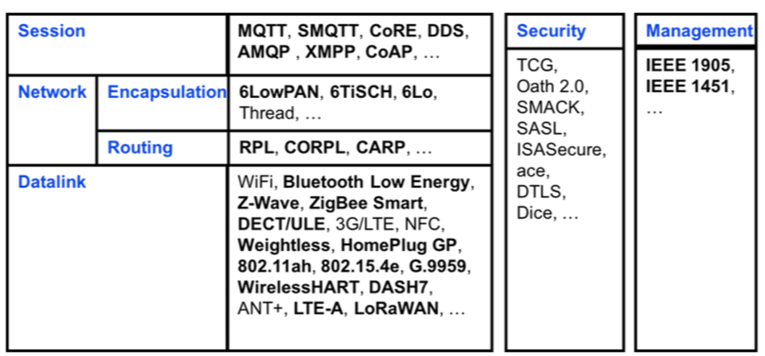
IoT protocol stack further details
Infrastructure (ex: 6LowPAN, IPv4/IPv6, RPL)
Identification (ex: EPC, uCode, IPv6, URIs)
Comms / Transport (ex: Wifi, Bluetooth, LPWAN)
Discovery (ex: Physical Web, mDNS, DNS-SD)
Data Protocols (ex: MQTT, CoAP, AMQP, Websocket, Node)
Device Management (ex: TR-069, OMA-DM)
Semantic (ex: JSON-LD, Web Thing Model)
Multi-layer Frameworks (ex: Alljoyn, IoTivity, Weave, Homekit)

Slide 16
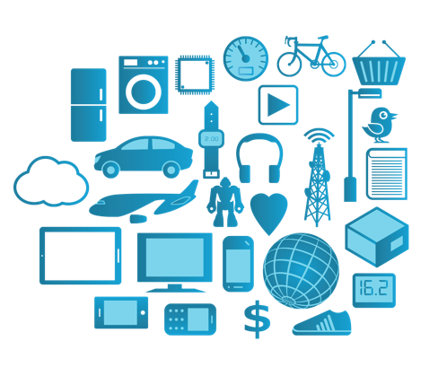
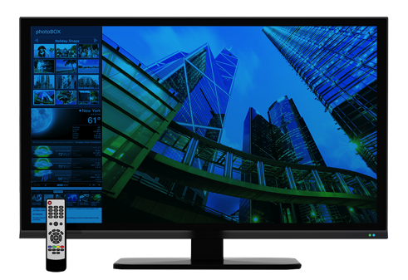
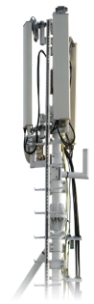


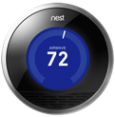

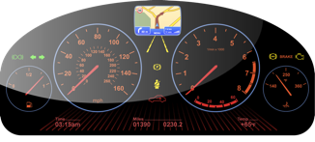
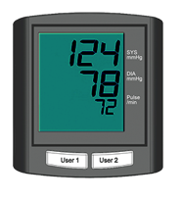
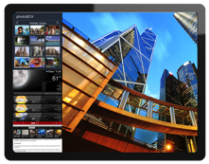



Technologies that enable IoT
Technologies that enable IoT
Little Devices and Little Data – embedded devices, e.g. wearables, sensors
Standards that enable internet scale - standardised networking, e.g. wifi, 3G, LTE, Bluetooth Smart, browsers, Javascript, HTTP, TLS etc.
Web and community based development – eco-system enabled by trust, e.g. mbed, HTML5, etc.
Mobile computing – smart, low-power devices, e.g. smartphones, tablet
Source: ARM training kit

Slide 17



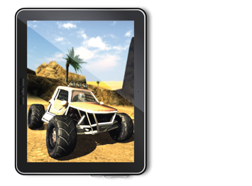

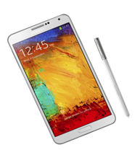
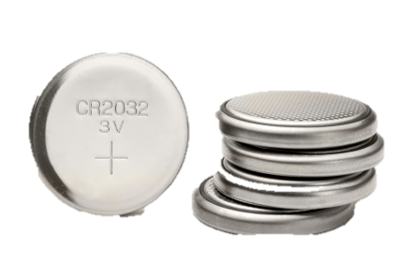

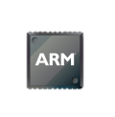
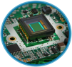
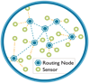


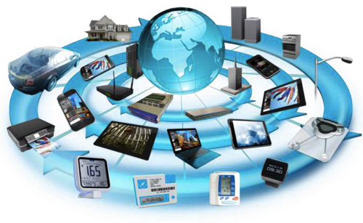

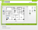




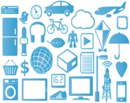



Technologies that Enable IoT example: ARM-based solutions
Mobile Computing
Little Devices and Little Data
Cortex-M
Internet of Things
Devices
Applications
Big Data
Cortex-A
Web and community based development
IEEE 802.15.4
1,000,000s
Platform
LTE
3G
Standards that enable INTERNET scale
Source: ARM training kit

Slide 18
End of Session

